Slide 1
Introduction to Computer Programming Lecture 10.1:
Writing Programs: Working with data
Hemma Philamore
Department of Engineering Mathematics

Slide 2
Introduction to Computer Programming Lecture 10.1.a:
Object Oriented Programming with Classes
Hemma Philamore
Department of Engineering Mathematics

Slide 3
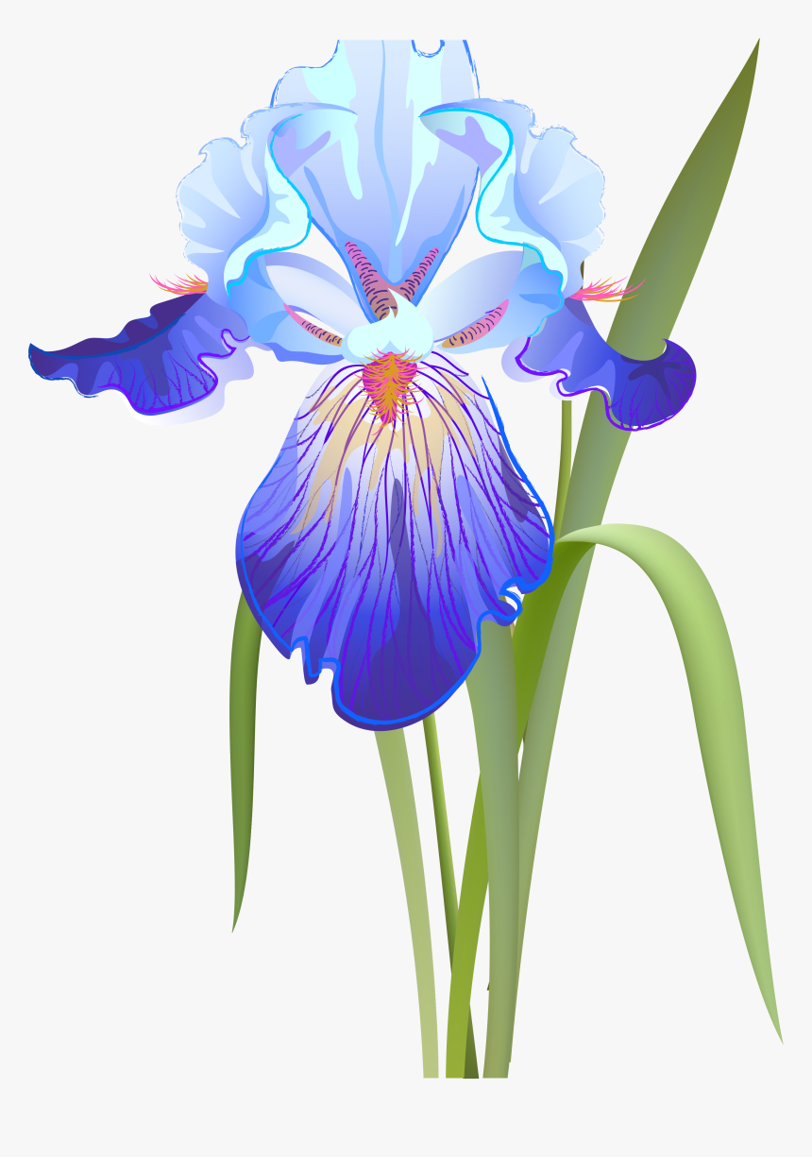

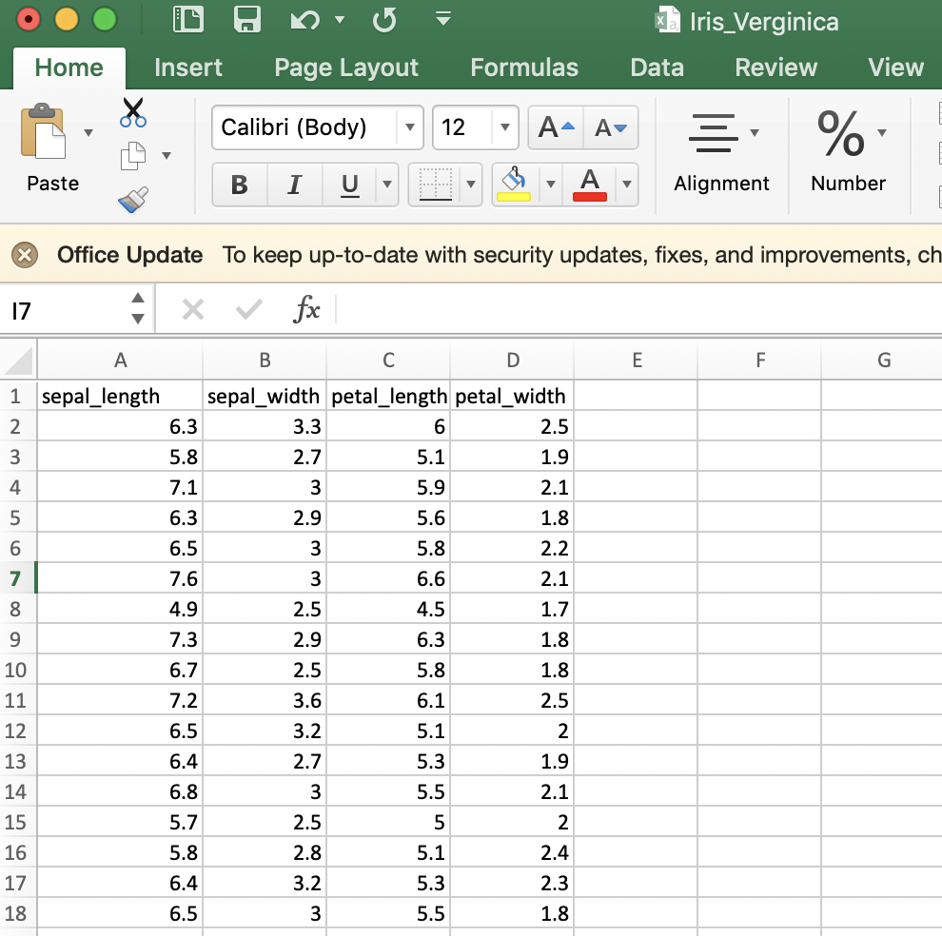
Example: Iris data set
You are working in a lab where data is collected on iris flower samples.
.csv file for each iris species
Four measurements for each sample:
Sepal length
Sepal width
Petal length
Petal width

Slide 4
Example: Iris data set
Start
You must write a program that can extract data about a species from the .csv file.
The data about different species should be extracted within the same program so that values for one species can be plotted against another.
﻿Open file
﻿﻿Contents to data structure
﻿Separate headings and numerical data
﻿Data to numpy array
﻿Extract data:
Sepal width
Petal length
Average sepal width
Maximum sepal length

Slide 5
Introduction to Computer Programming Lecture 10.1.b:
Object Oriented Programming with Inheritance
Hemma Philamore
Department of Engineering Mathematics

Slide 6
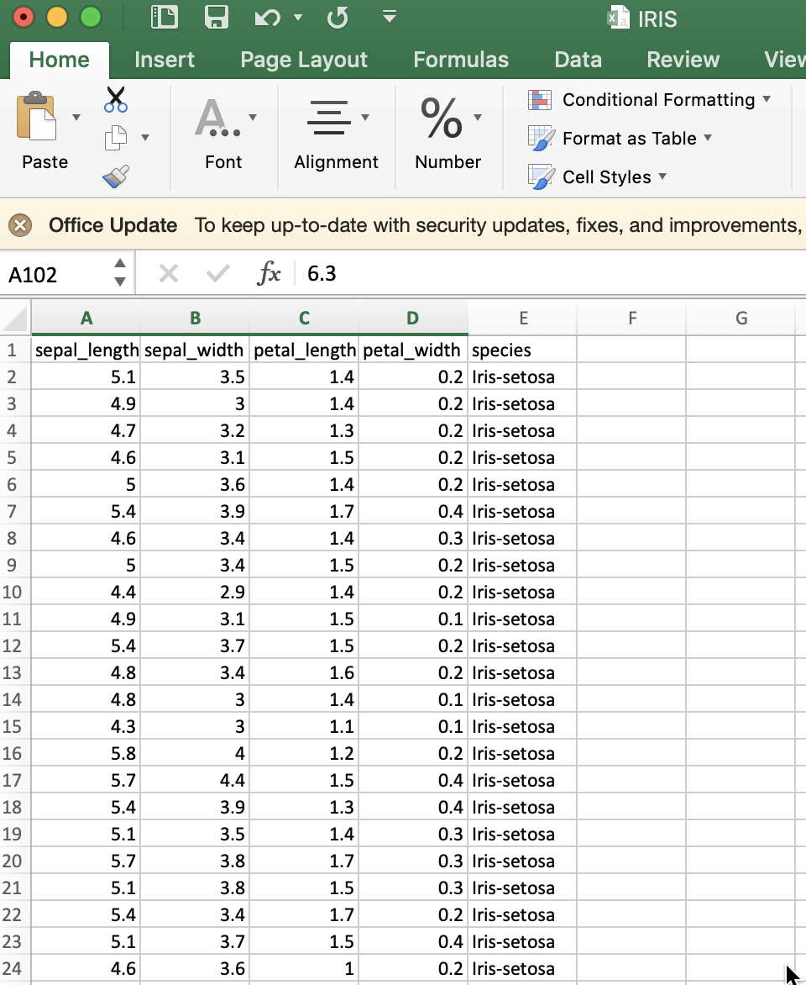
Example: Iris data set
The lab changes its file system for storing data.
Update your program so that it accepts the new data format.
The data for all species are now stored in a single file
There is an additional column which shows the species of each iris sample

